Slide 1
Sustainable Lignin Polymer Foaming Using High Pressure Carbon Dioxide
Razan Altarabeen, Christin Zimmer, Carsten Zetzl, Irina Smirnova
Institut für Thermische Verfahrenstechnik, Technische Universität Hamburg
Jahrestreffen der ProcessNet-Fachgruppe Hochdruckverfahrenstechnik (HDVT), 2021

Slide 2

Porous Lignous Organic Materials

Slide 3
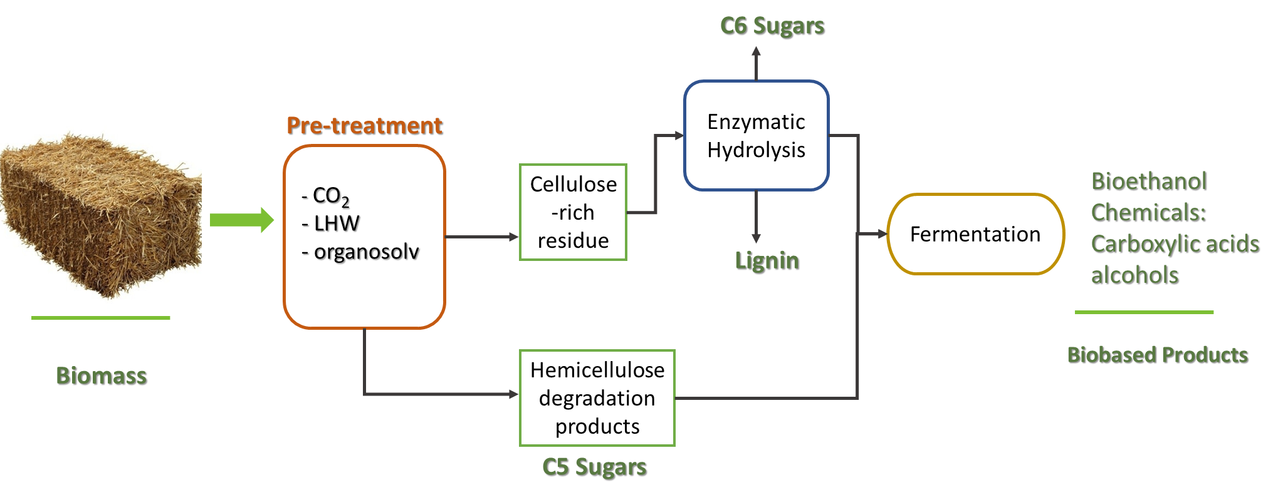
Biorefinery

Slide 4

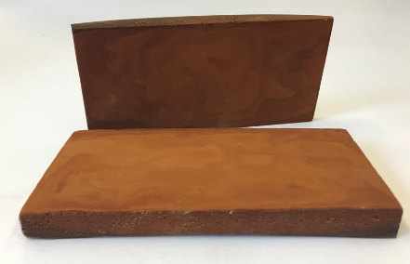
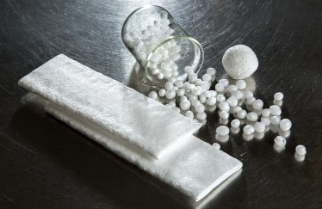
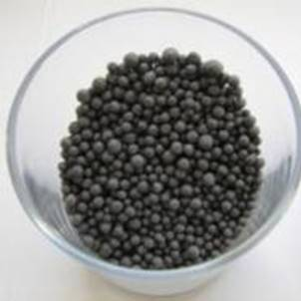
Objective
Increase demand of polymeric foams
Target properties
Lignin polylactide (PLA) foams
Sustainable resources

Slide 5
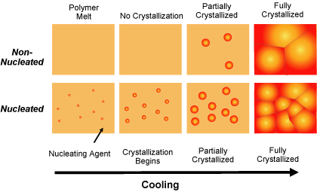
Introduction: lignin as nucleation agent
Provides nucleation sites
Improves crystallization kinetics
Biodegradable
Enhances flame retardancy
https://polymer-additives.specialchem.com/centers/polypropylene-nucleation-center/how-do-nucleating-agents-work

Slide 6
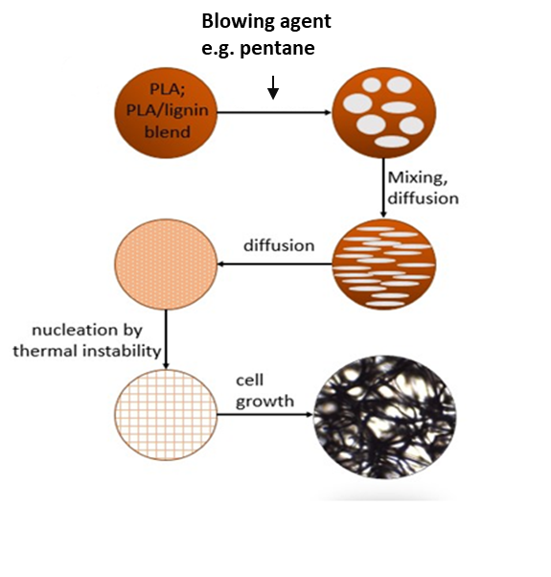
Introduction: conventional process
Solid state foaming:
e.g. Thermally induced process using pentane
Melt state foaming:
e.g. Addition of blowing agent during extrusion

Slide 7
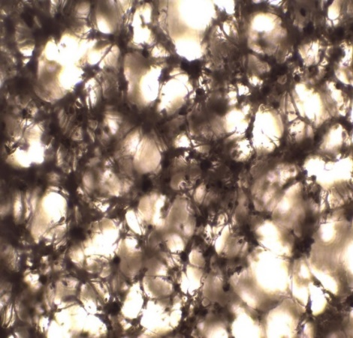
Introduction: conventional process
Every additive plays an important role into building the final foam structure
Blowing agent
Foaming
Porosity
density
Nucleation agent
Cellular structure
Filler
Stability
Particle size
Melting point
Polymeric Matrix

Slide 8

Blowing agents
Blowing agent
Chemical blowing agent
e.g. Sodium bicarbonate
Physical blowing agent
e.g. chlorofluorocarbons (CFCs) & hydrochlorofluorocarbons (HCFCs)
No good control of the porosity
presence of residues
Greenhouse gases
CO₂ as an environment-friendly alternative?

Slide 9
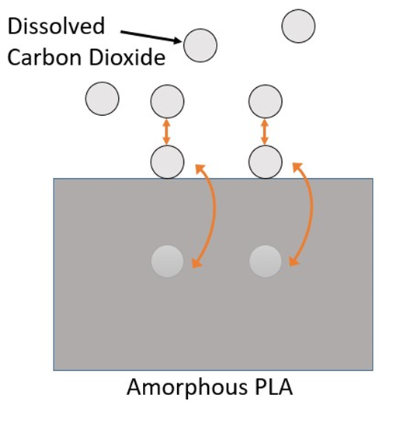
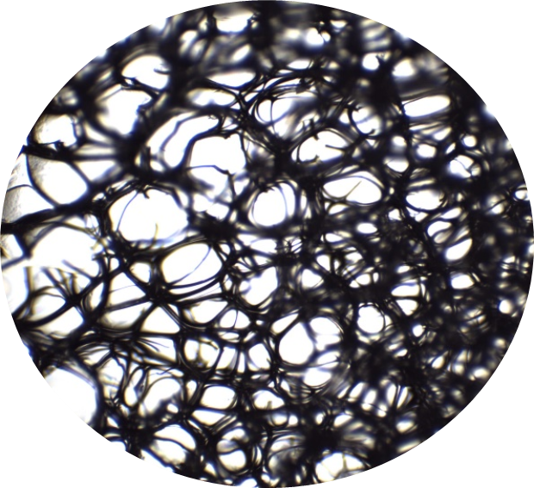

CO₂ as a blowing agent
Saturation of CO₂
high pressures
Good solubility in polymer blends
Acts as a plasticizer
Lowers viscosity and glass transition temperature
Controls pore generation and growth
Introduction of a thermodynamic instability
Nucleation of cells
Super-saturation reducing the pressure
or increasing the temperature.

Slide 10
Experimental Plan
Extrusion
Lignin characterization
Compounding and extrusion
Foaming behavior
Batch CO₂ foaming
Other blowing agents foaming
Continuous foaming
Extrusion coupled with CO₂ foaming
Characterization tests

Slide 11
Materials
Name | Extraction Method | Klason content | Particle size (d90/µm) | Moleculer weight (kDa) | Mositure content (wt%)
Hydrolytic 1 | Novel Biorefinery | 68.2% | 72.4 | 8.0 | 1.9
Hydrolytic 2 |  | 78.9% | 38.6 | 13.3 | 4.8
Supercritical water |  | 80.8% | 36.2 | 60.1 | 0.6
Lignosulfonate | Sulfite pulping | - | 159.2 | - | 5.6
Soda | Soda pulping | 95% | 89.6 | 9.2 | 5.2

Slide 12
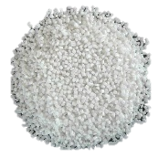
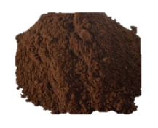
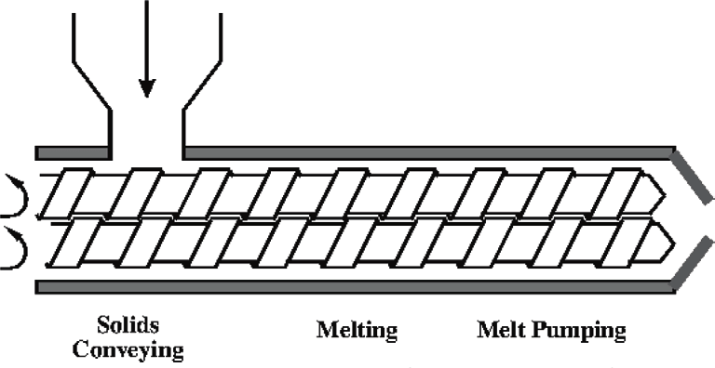
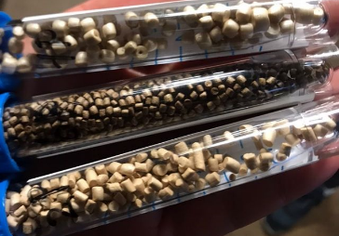
Methodology
First step: Compounding and Extrusion
Twin screw extruder
T = 170 °C
rpm= 180 U/min
Lignin PLA foams with 10, 20 and 30 wt% lignin

Slide 13
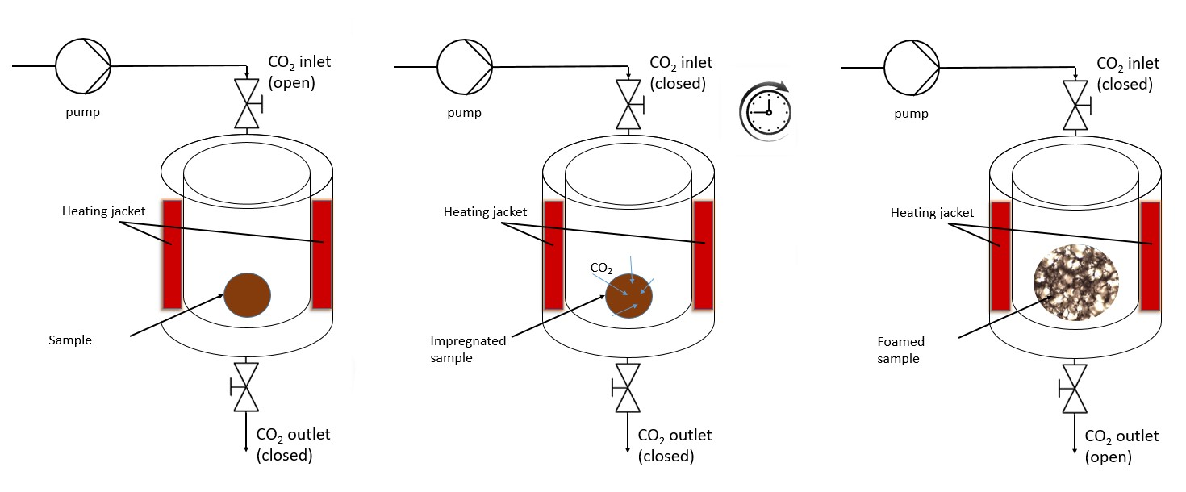
Methodology
Second step: Batch CO₂ Foaming
Pressure (bar): 60
Temperature (°C): 60
Retention time: 120 minutes
Depressurization time (seconds): 60 ± 5

Slide 14
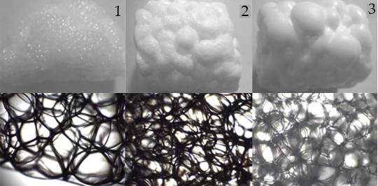
Results
Second step: Batch CO₂ Foaming
Short depressurization time → Homogenous cellular structure
Long depressurization time → cell coalescence
, tdep,1 = 60 s, tdep,3 = 74 s, tdep,3 = 152 s
Depressurization time (seconds): t₁ = 60 , t₂ = 74 , t₃ = 152

Slide 15
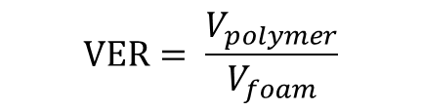
Results: Volume expansion ratio
$$VER= \frac{V_{polymer}}{V_{foam}}$$
The change of the foam VER varies with lignin type.
10: 10 wt% lignin in PLA foam
20: 20 wt% lignin in PLA foam
30: 30 wt% lignin in PLA foam
Hydrolytic 1
Hydrolytic 2
Notes:
E: Lower Tg C: 70.49
F: high thermal Stability Tg
F: D90 29,8 but higher glass transition temp – higher thermal stability

Slide 16
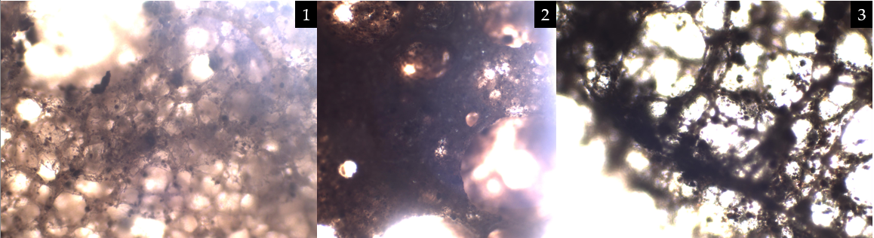
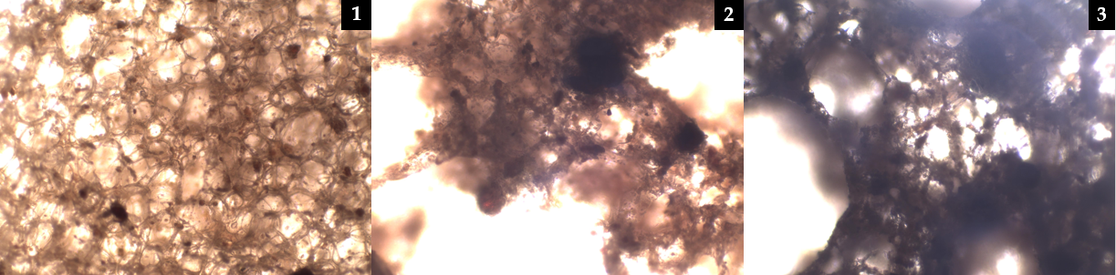
Results: Volume expansion ratio
Influence of molecular weight (thermal stability) on melt strength is more pronounced at higher lignin concentration.
Higher molecular weight → Higher melt strength → More stable cellular structure
1
2
Supercritical water lignin with:
(1) 10 and (2) 30 wt %.
Molecular weight: 60.1 (kDa)
1
2
Hydrolytic 1 lignin with:
(1) 10, and (2) 30 wt%.
Molecular weight: 8.0 (kDa)

Slide 17
Results: Cellular Structure
Lignin PLA foams with the same lignin concentration 20 wt%
Higher moisture content → Heterogeneous cellular structure
Hydrolytic 2: moisture 4.8 wt%
Hydrolytic 1: moisture 1.9 wt%

Slide 18
Results: Density
The Lignin PLA foams had an average densities of 0.19 g/cm³.
Higher klason content → lower density
Rarrange in respect to klason content
H1
Hydrolytic 1
H2
Hydrolytic 2
SW
Supercritical
water
L
Lignosulfonate
S
Soda
10: 10 wt% lignin in PLA foam
20: 20 wt% lignin in PLA foam
30: 30 wt% lignin in PLA foam

Slide 19
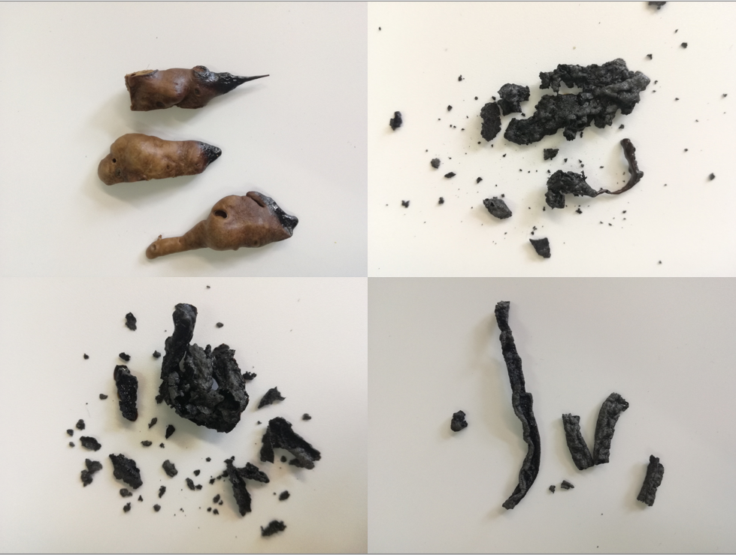
Results: Flammability
lignin can be considered a bio-flame retardant owning to its char formation of 35-40% *
during combustion.
The formed charred layers protect the underlying materials from rephrase
the transferred heat and flame and act as a physical barrier.
Sample | Flame spread speed (mm/min)
Pure PLA | 17.4
10% hydrolytic 1 lignin | 12 .0
30% hydrolytic 1 lignin | 3.6
Charring behavior of 30 wt % lignin
PLA foams

Slide 20
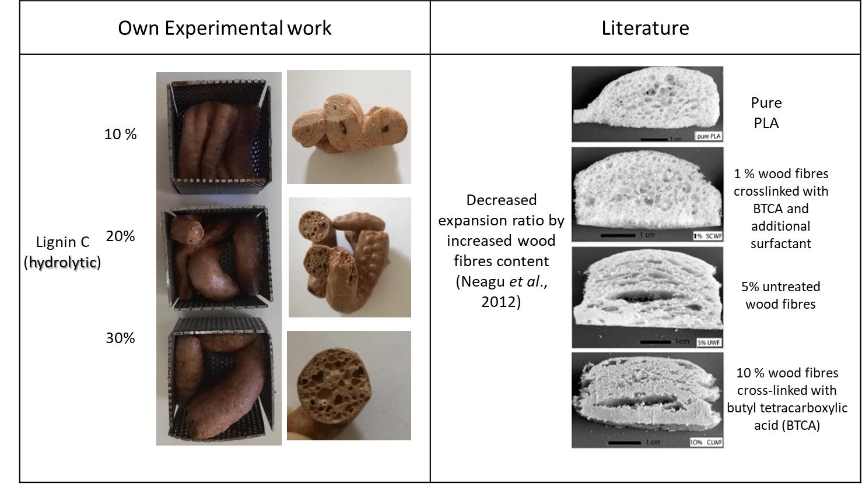
Results: Cellular Structure
Lignin provides better foaming in comparison with wood fibers *.

Slide 21

Outlook: Extrusion process assisted by carbon dioxide

Slide 22
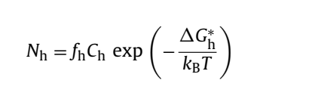
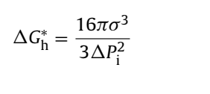
Key Parameters:
Nucleation mechanism
Lower gibbs energy → higher nucleation:
gibbs energy changed with CO₂
(lower than solubility limit, Homogenous nucleation)
gibbs energy changed with Lignin
Addition of term to describe nucleation by lignin
(Heterogeneous nucleation)

Slide 23
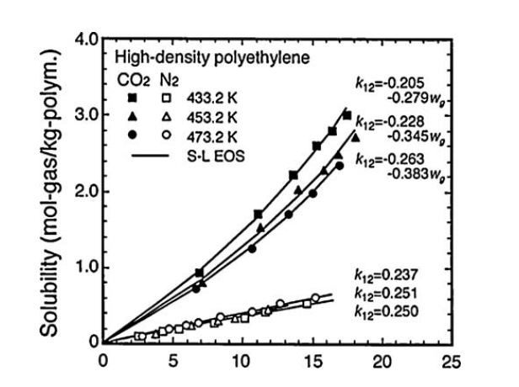
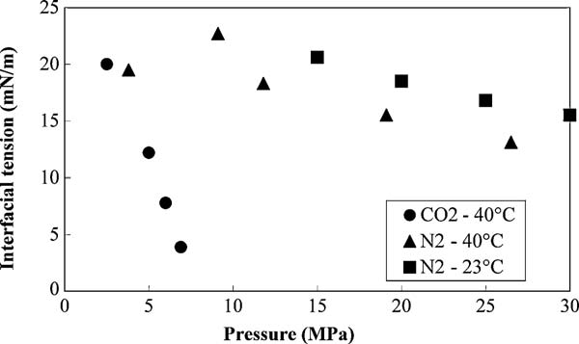
Key Parameters:
Solubility of CO₂
Solubility
Interfacial tension
Nucleation rate
Finer pore structure

Slide 24
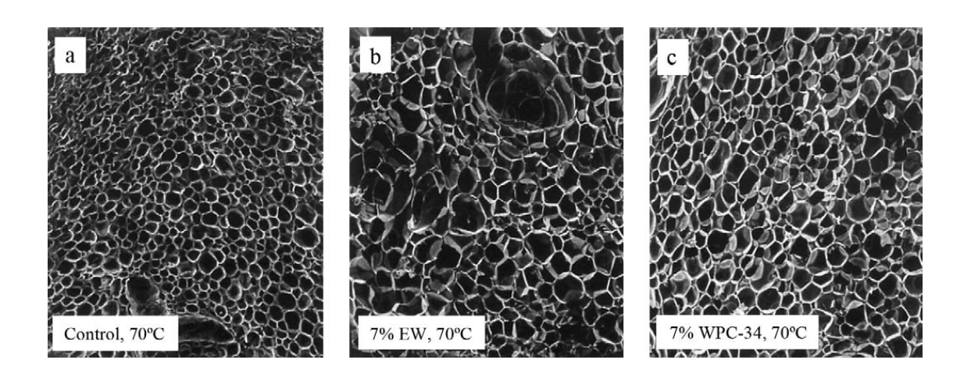
Key Parameters
Glass transition temperature (Tg)
Faster pressure drop → faster increase in Tg
Increase in high molecular weight lignin → faster increase in Tg
a
b
Extrudates oven dried at 70 ◦C; (a) control, (b) 7% whey protein concentrate
Analogy to use of lignin as stabilizing agent to enhance Tg

Slide 25
Next steps
Understanding nucleation mechanism in continuous CO₂ foaming
Influence of lignin percentages on Tg (or critical temp)
Solubility of CO₂ in lignin/polymer blends
Describing the heterogeneous nucleation rate

Slide 26
References
[1] R. Auras, B. Harte, and S. Selke, “An Overview of Polylactides as Packaging Materials,” Macromol. Biosci., vol. 4, no. 9, pp. 835–864, Sep. 2004, doi: 10.1002/mabi.200400043.
[2] Q. Zong, A. Xu, K. Chai, Y. Zhang, and Y. Song, “Increased expansion ratio, cell density, and compression strength of microcellular poly(lactic acid) foams via lignin graft poly(lactic acid) as a biobased nucleating agent,” Polym. Adv. Technol., p. pat.4944, Jun. 2020, doi: 10.1002/pat.4944.
[3] W. Yang et al., “Synergic effect of cellulose and lignin nanostructures in PLA based systems for food antibacterial packaging,” Eur. Polym. J., vol. 79, pp. 1–12, Jun. 2016, doi: 10.1016/j.eurpolymj.2016.04.003.
[4] M. Sauceau, J. Fages, A. Common, C. Nikitine, and E. Rodier, “New challenges in polymer foaming: A review of extrusion processes assisted by supercritical carbon dioxide,” Prog. Polym. Sci., vol. 36, no. 6, pp. 749–766, Jun. 2011, doi: 10.1016/j.progpolymsci.2010.12.004.
[5] D. L. Tomasko et al., “Development of CO2 for polymer foam applications,” J. Supercrit. Fluids, vol. 47, no. 3, pp. 493–499, Jan. 2009, doi: 10.1016/j.supflu.2008.10.018.
[6] H. Ruckdäschel, V. Altstädt, and A. H. E. Müller, “Foaming of Polymer Blends – Chance and Challenge,” Cell. Polym., vol. 26, no. 6, p. 14, 2007.

Slide 27
Thank you for your attention

